Slide 1
Basic Treatment Planning Mock

Slide 2
Q1
Draw a 6 MeV and 15 MeV electron PDD.
You are treating a skin cancer on the nostril with a 6 MeV beam, what do you need to consider?
The lesion is 1 cm, and you are using 1 cm of bolus. Is 6 MeV an appropriate energy?
Notes:
Irregular surfaces, angle of incidence, likely small field, shielding behind nostril, how much shielding if you were to use lead, what would you put on the lead and why

Slide 3
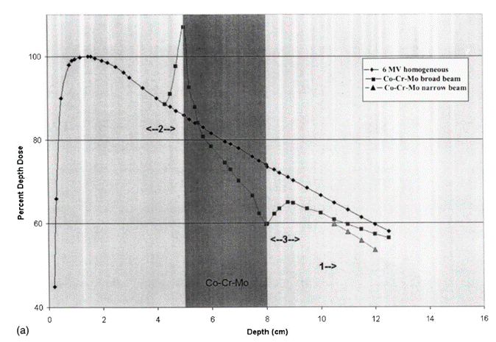
Q2
Draw the PDD for a 18 MV beam for the setup in the figure.
Explain the interactions taking place at ‘2’ and ‘3’.
Draw the PDD if Co-Cr-Mo were replaced with lung tissue.
How does your treatment planning system handle heterogeneous interfaces?

Slide 4
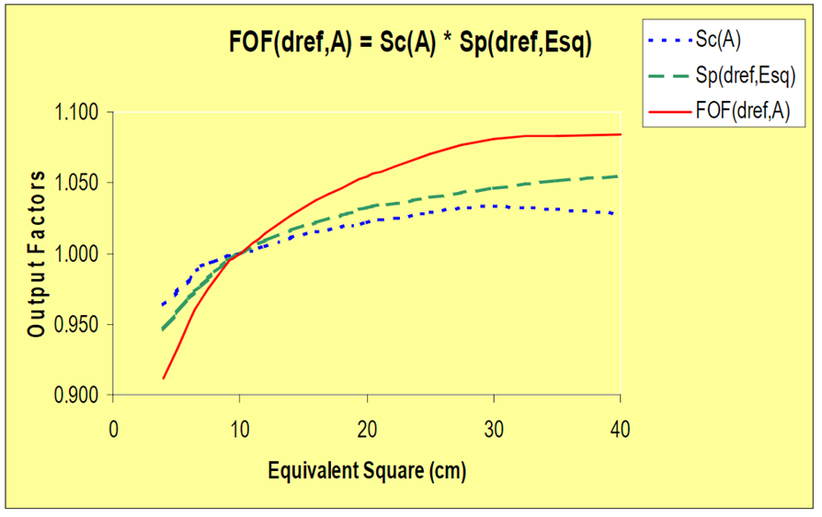
Q3
What variables are graphed in the following figure? Explain the reason for their behavior? Explain how these variables are measured?
Notes:
Vendor differences?

Slide 5
Q4
What is the SAD setup MU calc formula for photons? Explain the terms.
What is different for an electron MU calc? How would you determine the electron output factor for a cutout with FS of 8 cm x 12 cm?
What task group would you reference for MU calcs?

Slide 6
Q5
How do you treat a breast cancer with 3D planning technique
Immobilization used & simulation set up?
Usual Beam arrangement? Why? How does the beam arrangement change with nodal treatment volumes?
OARs you are concerned about and tolerances?

